Slide 1
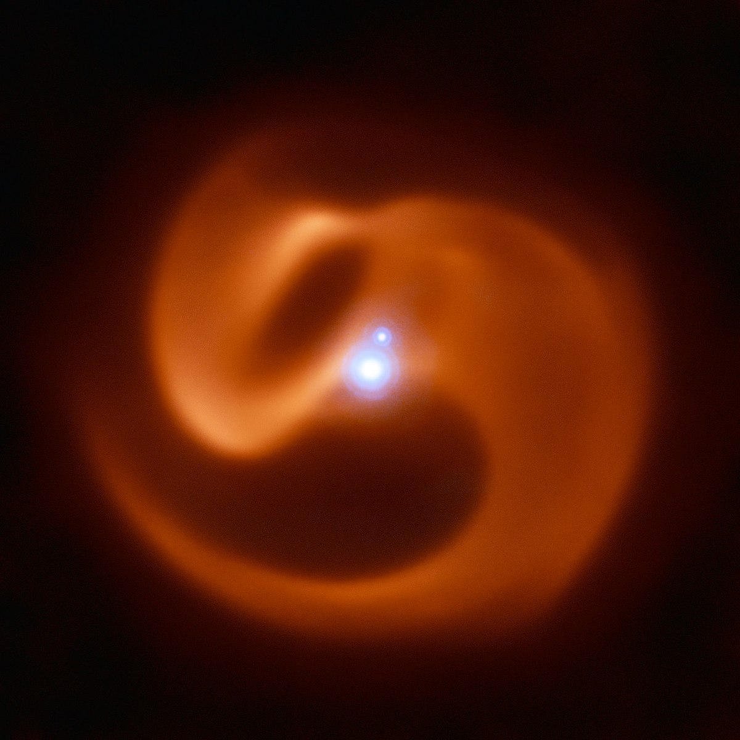
The Serpent Eating Its Own Tail
How strange geometry reveals some of the nastiest stellar interactions in the Galaxy
Ryan White, Macquarie University for the University of Sydney Astro Seminar

Slide 2
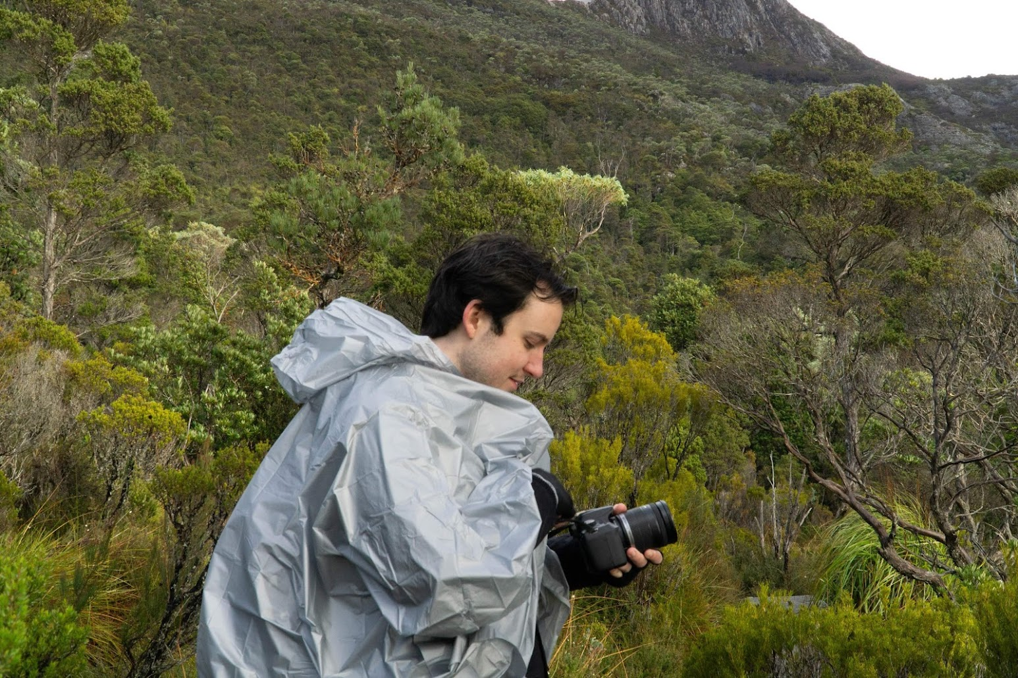
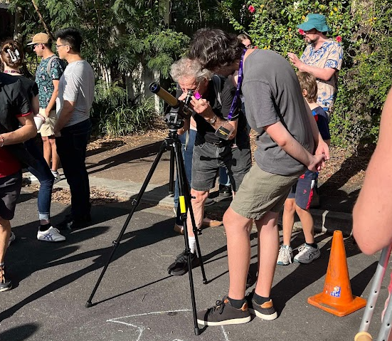

A little bit about me
UQ (Brisbane)
Undergrad + Honours at the University of Queensland
Recently moved to Sydney for MRes+PhD at Macquarie with Orsola De Marco and Ben Pope
I love some science outreach and teaching
Writer for astrobites
Always looking for more public outreach e.g. solar telescopes, talks
Macquarie Uni
(Sydney!)

Slide 3
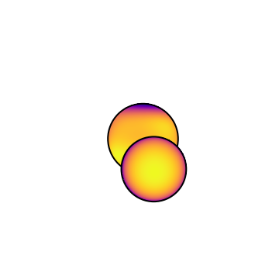
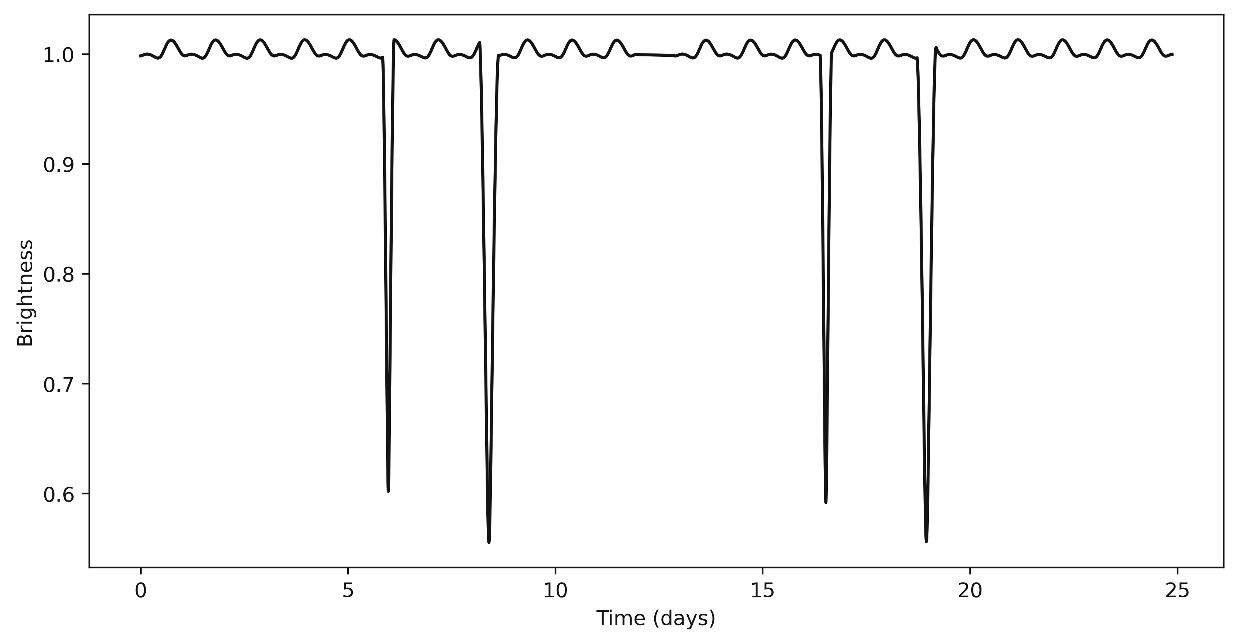
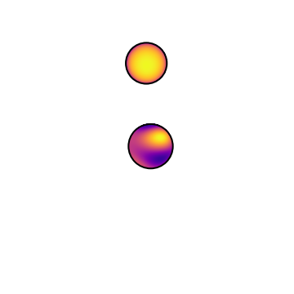

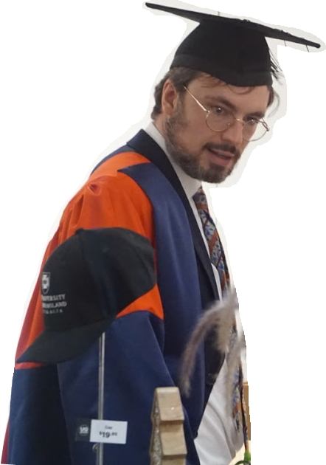
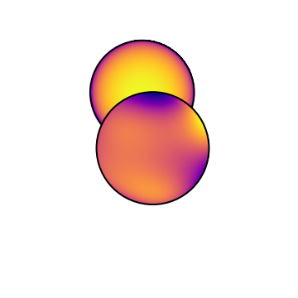
My previous work… at Uni of Queensland
Worked with Benjamin Pope and Shashank Dholakia to map the surface of the stars in DI Herculis using its TESS light curve

Slide 4
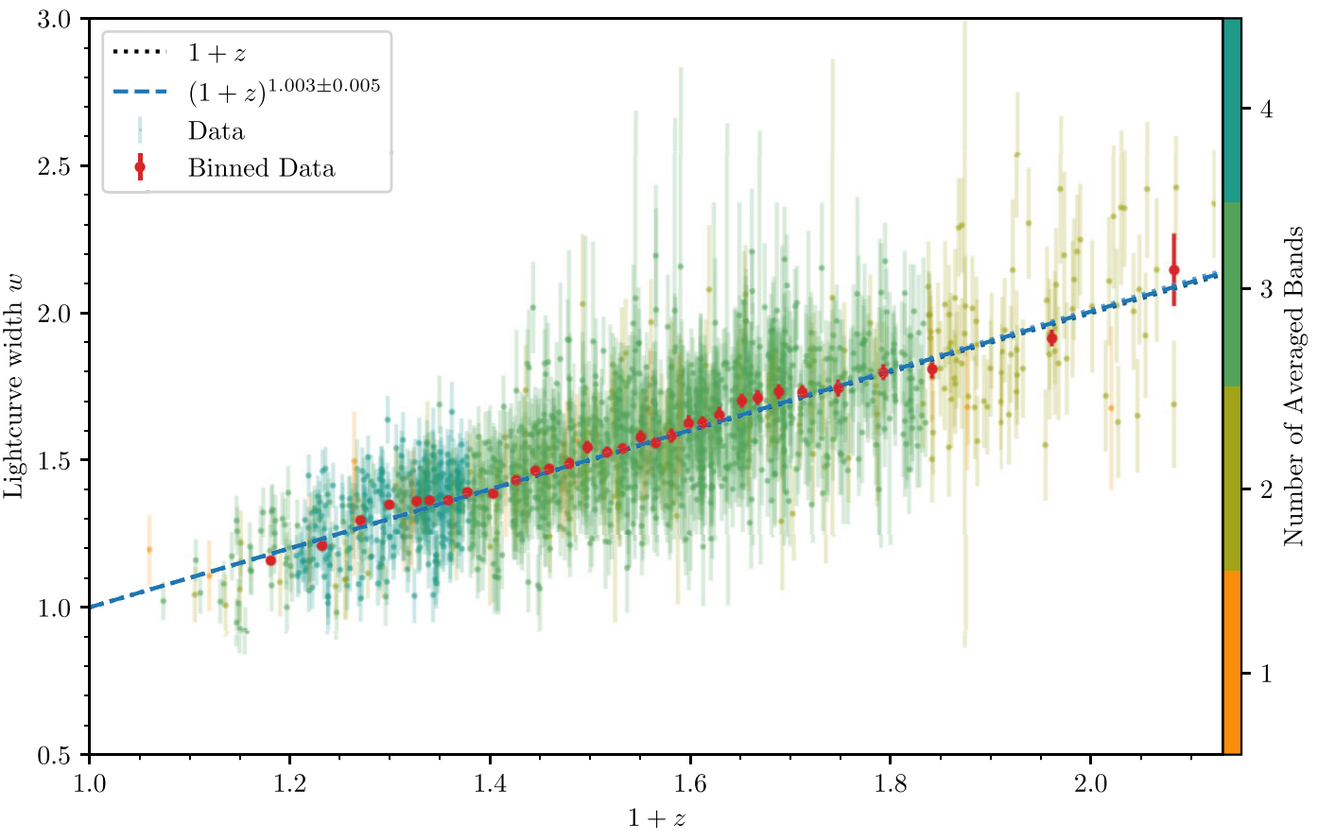
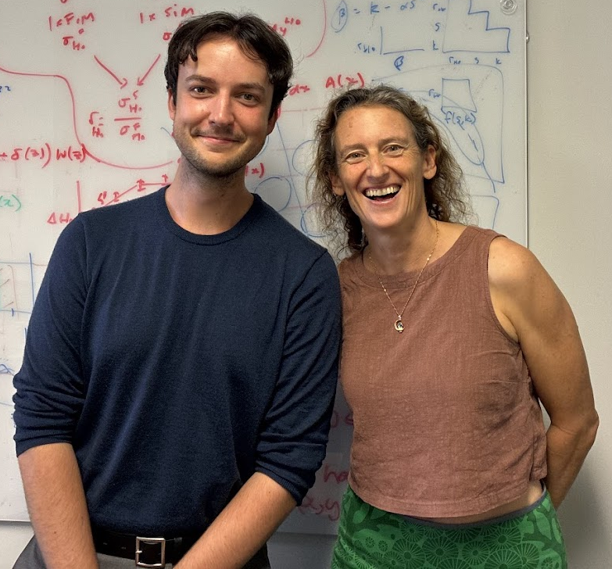
My previous work… at Uni of Queensland
Worked with Tamara Davis to show cosmological time dilation in ~1500 Type Ia supernovae from the Dark Energy Survey (DES)

Slide 5
































































































































































































































































































































































































































My previous work… at UQ
or

Slide 6
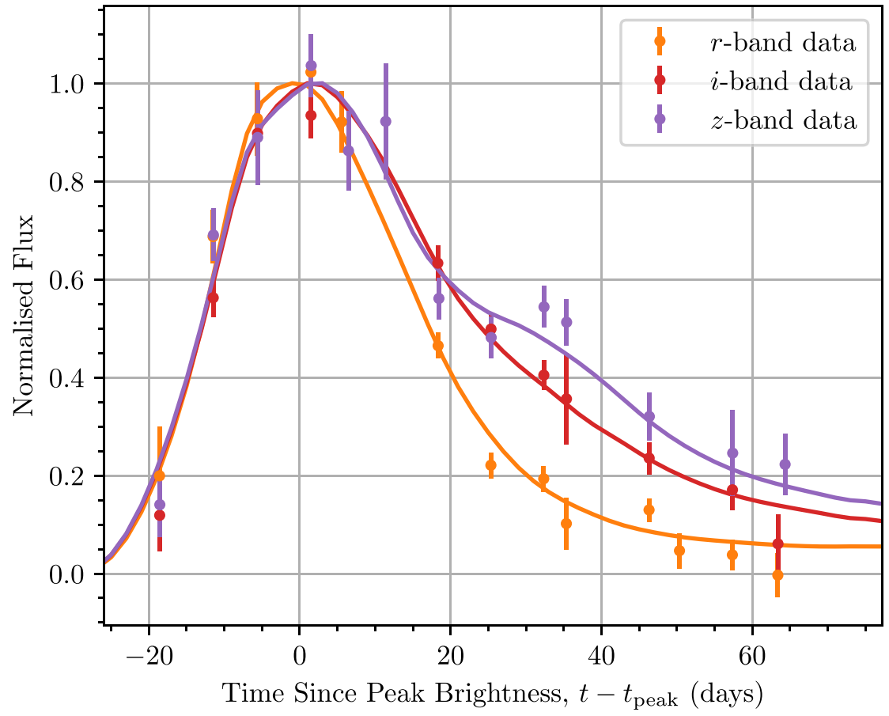
































My previous work… at UQ
Day 0
Day 20
Day 60

Slide 7
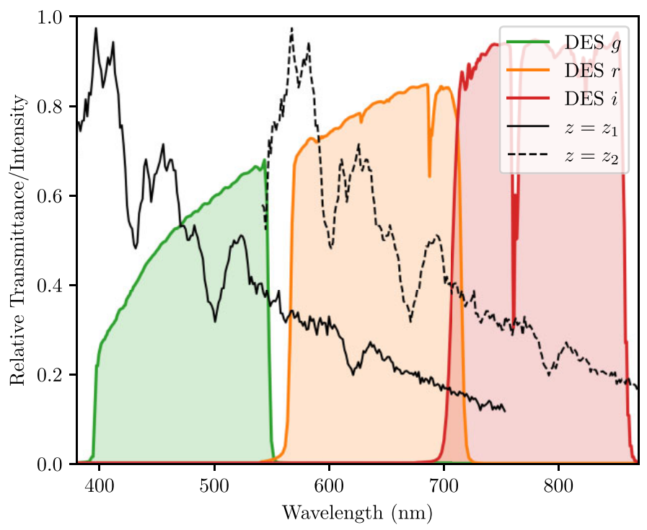

















My previous work… at UQ
Distance

Slide 8
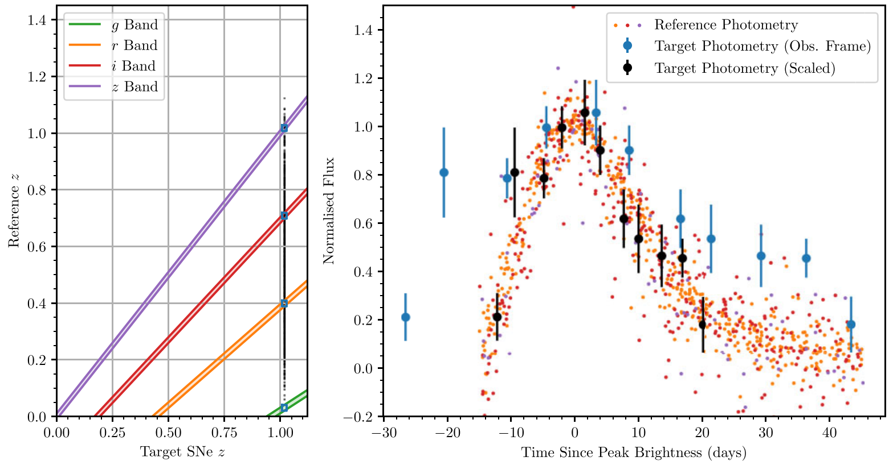
My previous work… at UQ

Slide 9
My previous work… at UQ
White, R. M. T., et al. (2024) "The Dark Energy Survey Supernova Program: slow supernovae show cosmological time dilation out to z~1.", MNRAS, 533, 3365

Slide 10
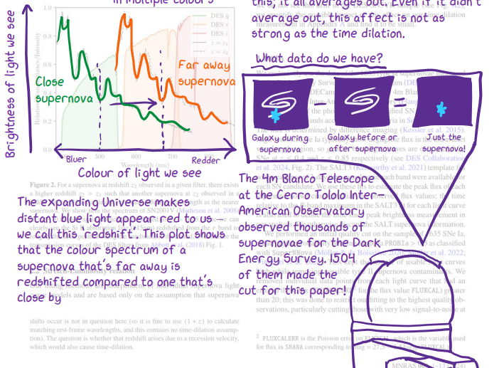
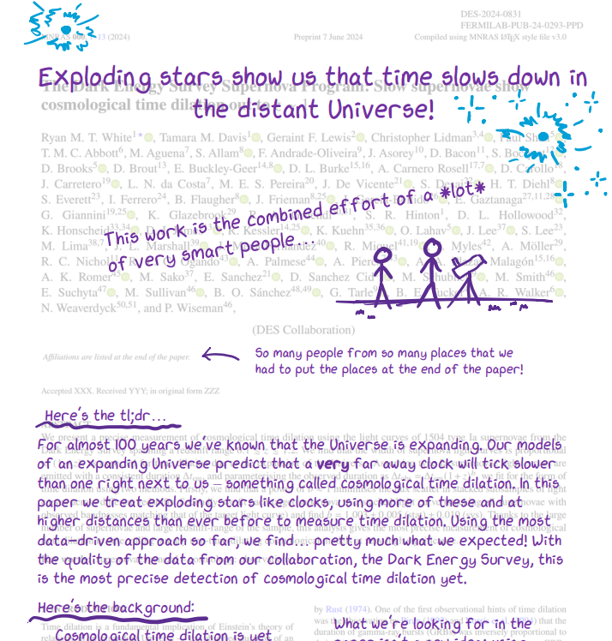
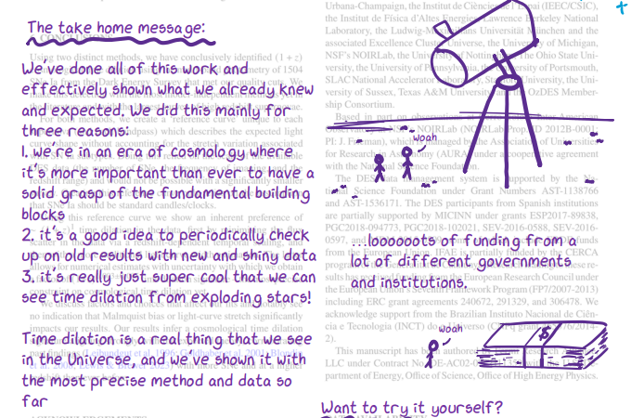

My previous work… at UQ
ryanwhite1.github.io/time-dilation.html

Slide 11




































































































































































My previous work… at Swinburne
Investigated the AGN channel of binary black hole mergers with Simon Stevenson
Integrating numerical relativity and disk models into the REBOUND code
This channel could explain very massive (hierarchical) mergers such as GW190521

Slide 12
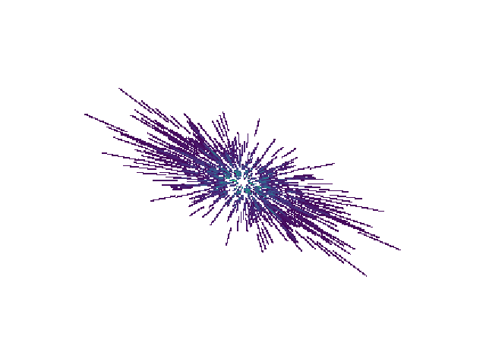
My previous work… at CSIRO
Developed a new method to search for Long Period Radio Transients with Andrew Zic
Transients are traditionally looked for by searching pixel by pixel in a set of images
With radio interferometric data, we can save computation (and time) by directly folding visibilities at trial periods

Slide 13
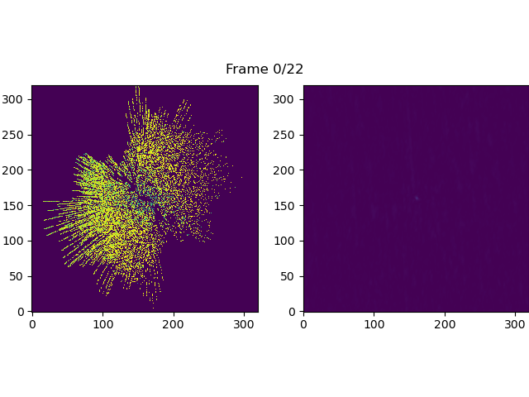
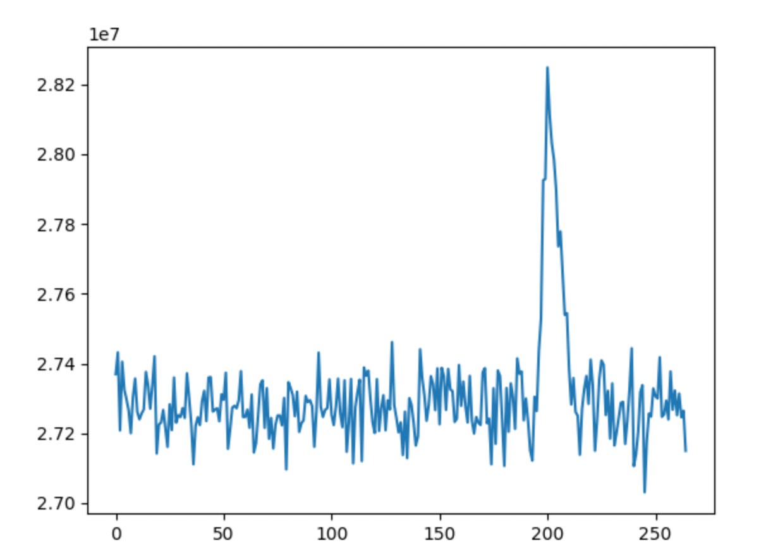
My previous work… at CSIRO
UV Plane
Image Plane
Folded Radio Lightcurve
Frame

Slide 14
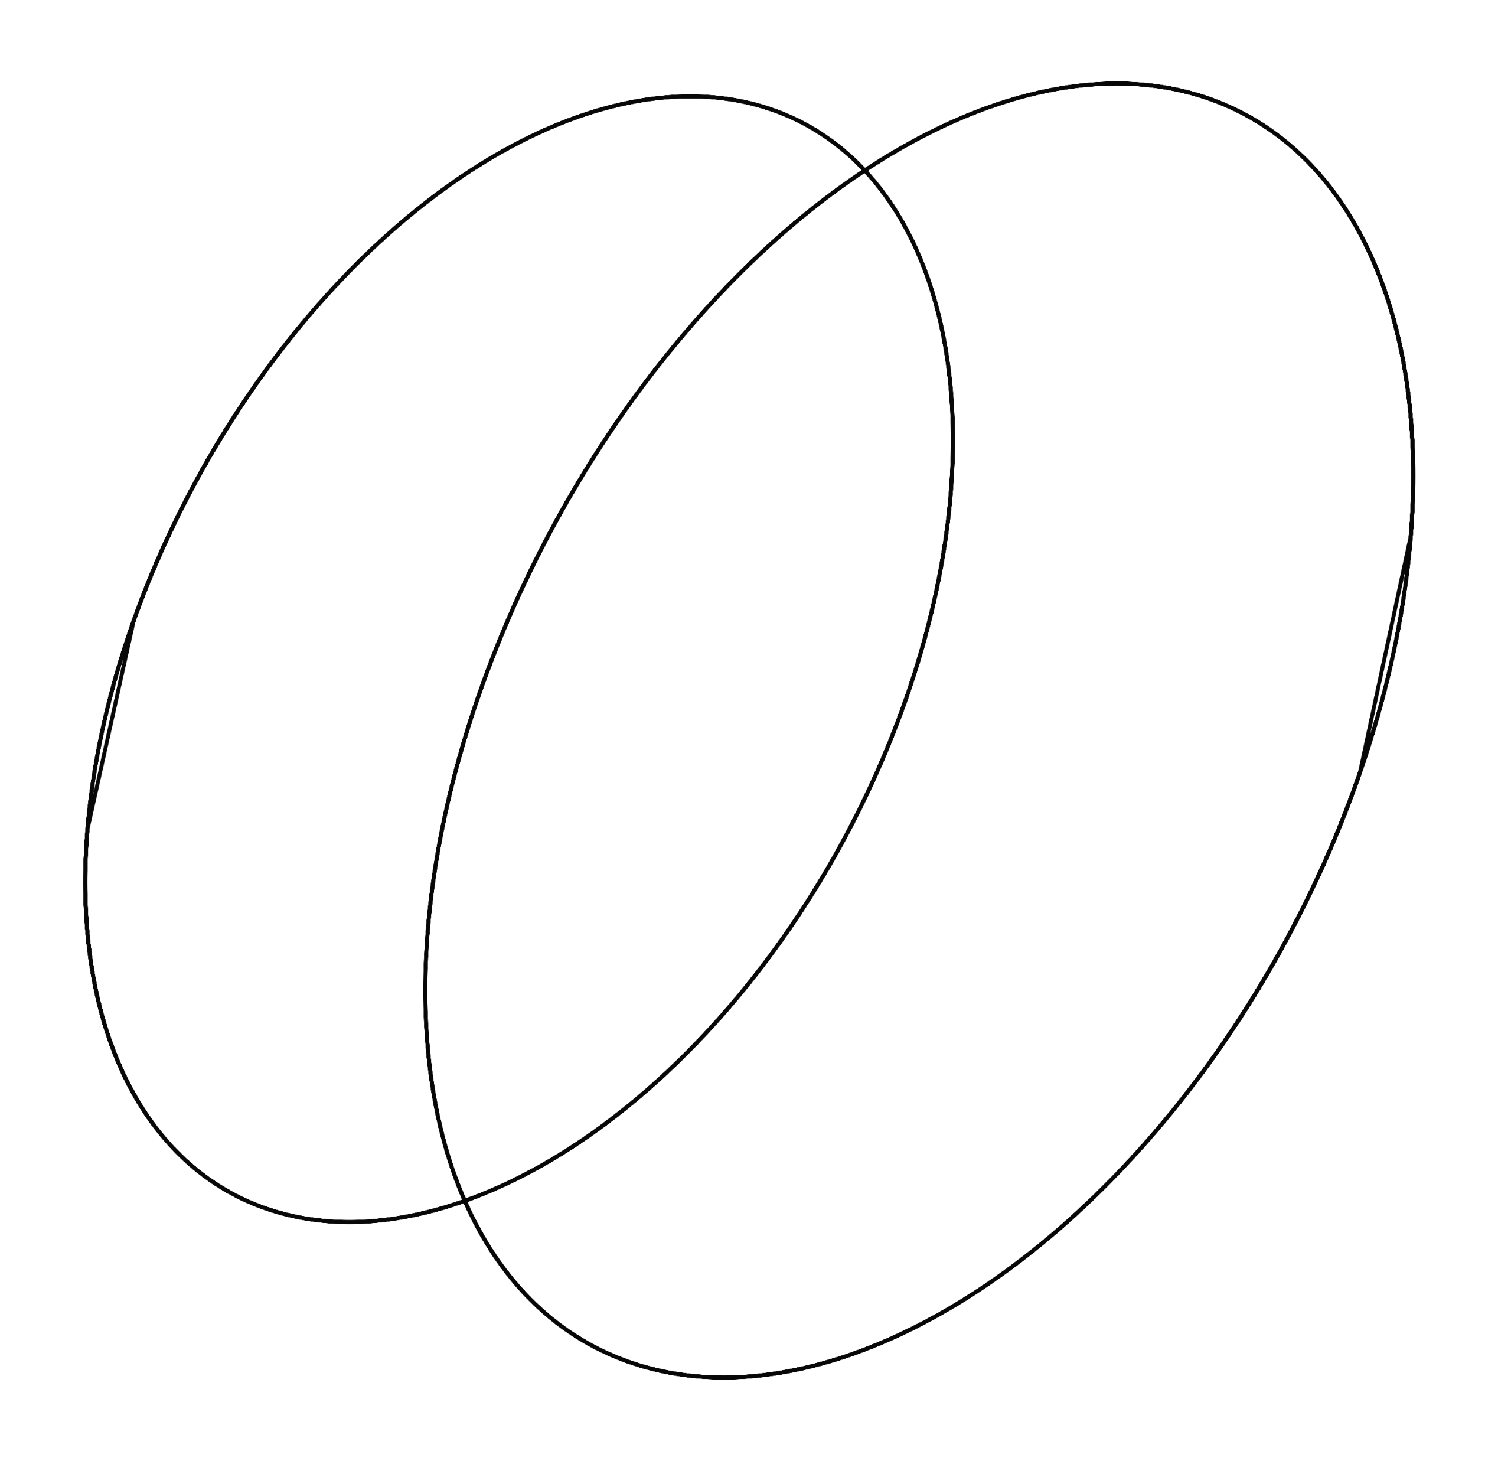































A common theme?

Slide 15
Colliding Wind Binaries

Slide 16
Colliding Wind Binaries
Are the dominant influences on their environment,
made up a large part of the Universe’s early carbon content,
allow us to peer into binary stellar evolution and the evolution of massive stars,
and just look unreasonably cool.
Apep with ESO’s VLT

Slide 17
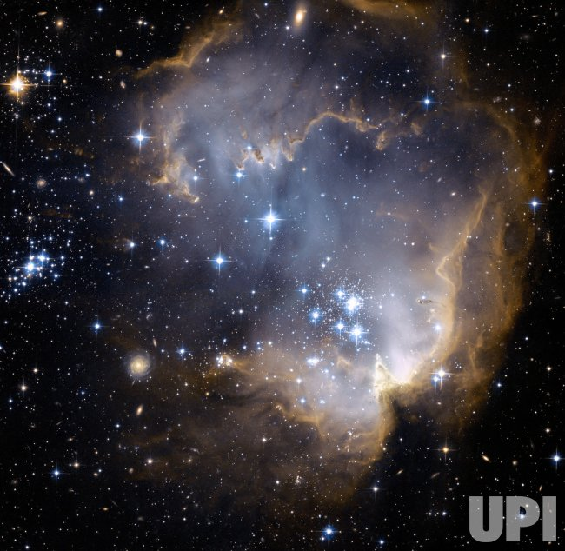


































































A broad overview of massive stellar evolution
Neutron Star
OB Star
Red Supergiant
Then spends the majority of its life on the main-sequence burning hydrogen into heavier elements
Blue Supergiant
Supernova
Our massive star is
born from the collapse
of a molecular cloud
Wolf-Rayet Star
Black Hole

Slide 18
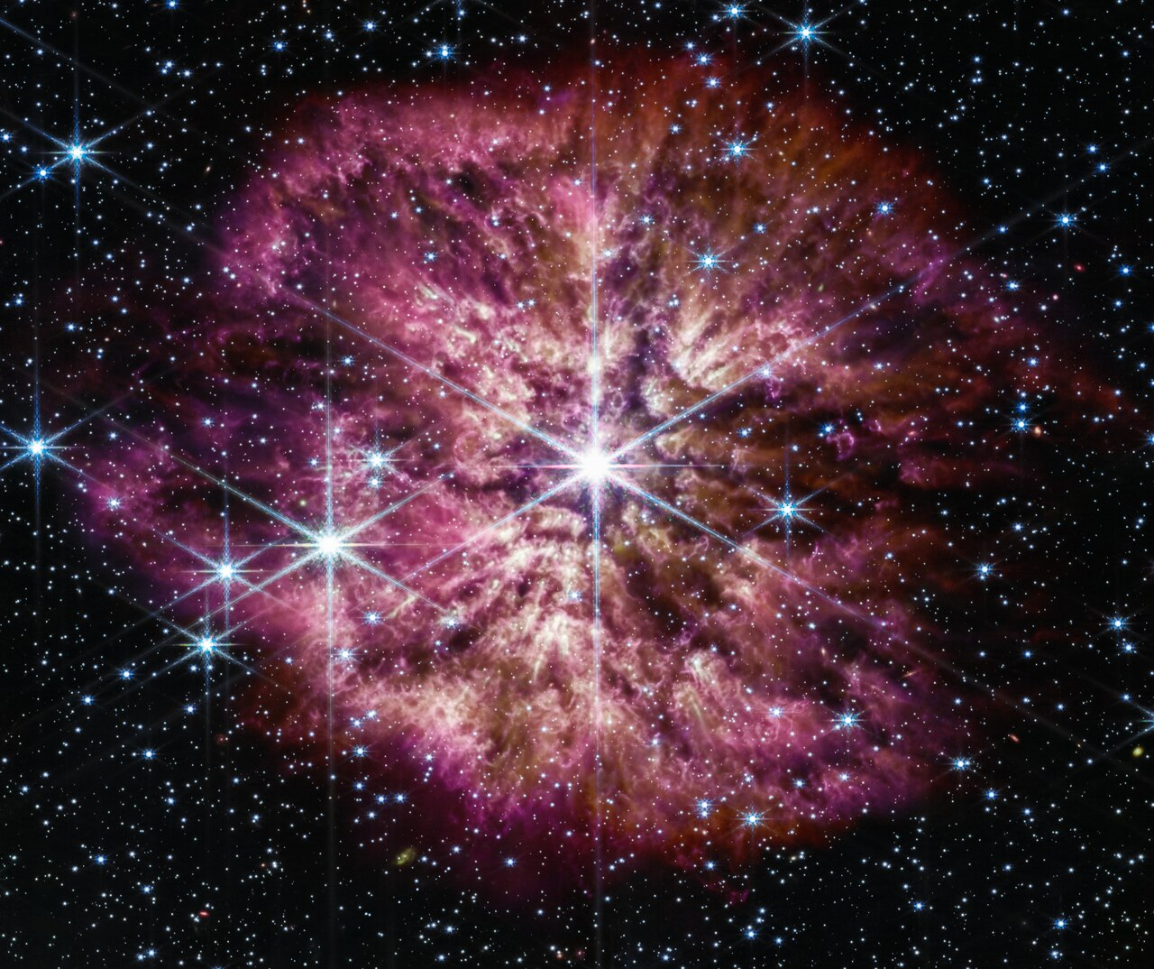
Wolf-Rayet stars
End-of-life phase of the most massive stars
Very short lived and rare
Extremely high mass loss rates and fast winds
~10⁻⁵-10⁻⁴ M⊙/yr
500-3000 km/s
SNe Ib/c progenitors
WR 124 with NASA/ESA’s JWST

Slide 19
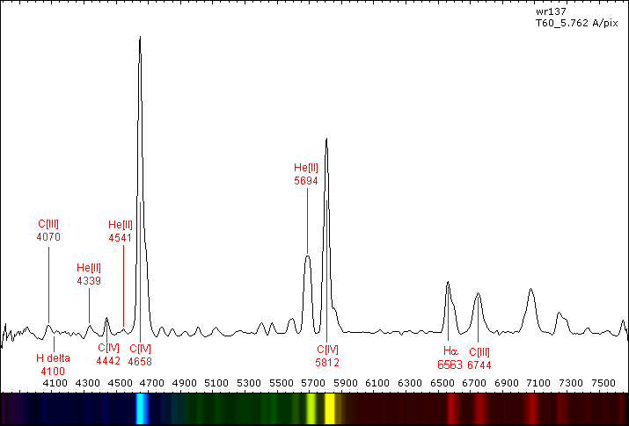





















Wolf-Rayet stars
C/N/O Core
He Shell

Slide 20


















































A broad overview of massive stellar evolution
binary
O+OB Stars
Mass Transfer
First SN
Stellar
Merger
Final Product
Second SN
Our massive stars are
born from the collapse
of a molecular cloud

Slide 21








































Wolf-Rayet Colliding Wind Binaries
Wind Mixing Region
WR Star
OB Star
Wind-Wind Shock
OB Wind Region
WR Wind Region
Wind Mixing Region

Slide 22
Wolf-Rayet Colliding Wind Binaries
Wind Mixing Region
WR Star
OB Star
Wind-Wind Shock
OB Wind Region
WR Wind Region
Wind Mixing Region

Slide 23
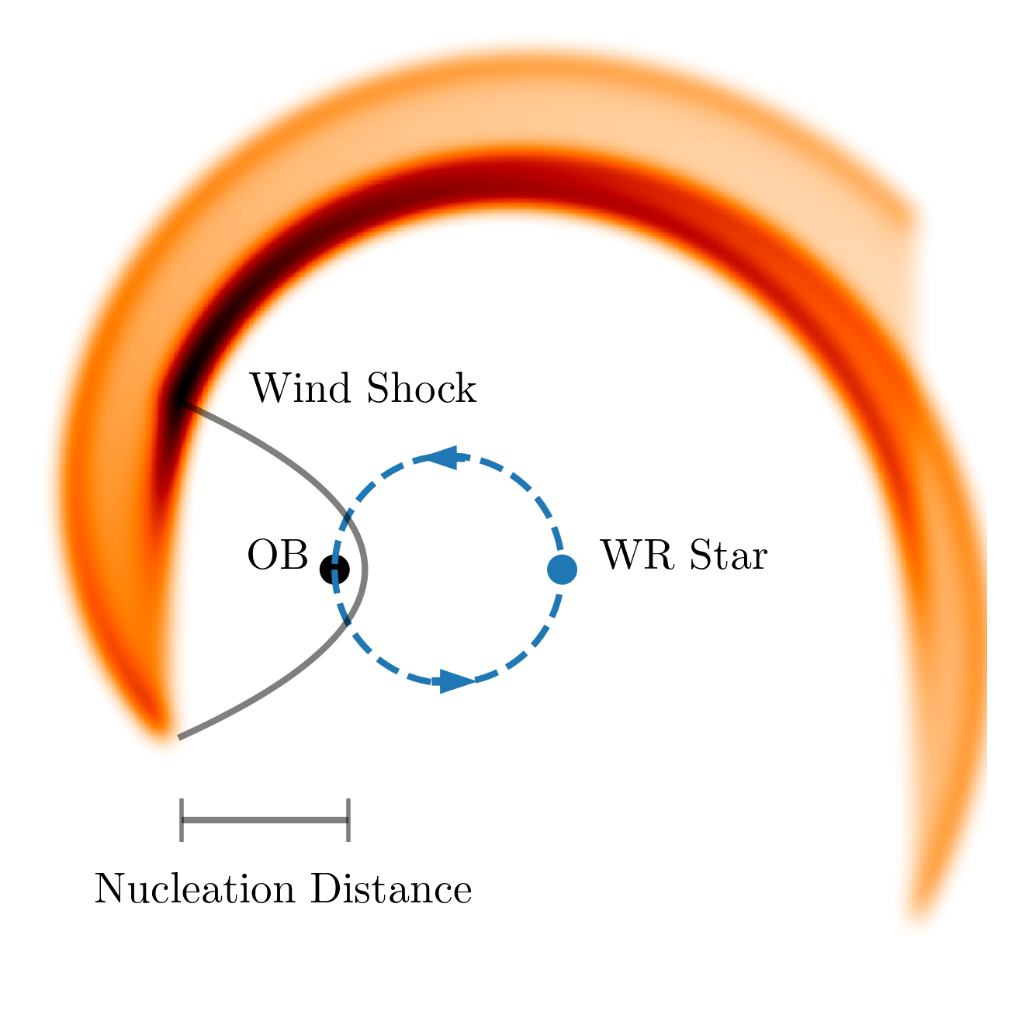
Wolf-Rayet Colliding Wind Binaries
Intense dust formation takes place in systems with WC stars
Forms in a hollow cone tracing the shocked wind
This occurs far enough ‘downstream’ of the shock once the wind is mixed and cooled
The dust expands away from the stars
The orbital motion of the binary wraps this dust into a spiral

Slide 24
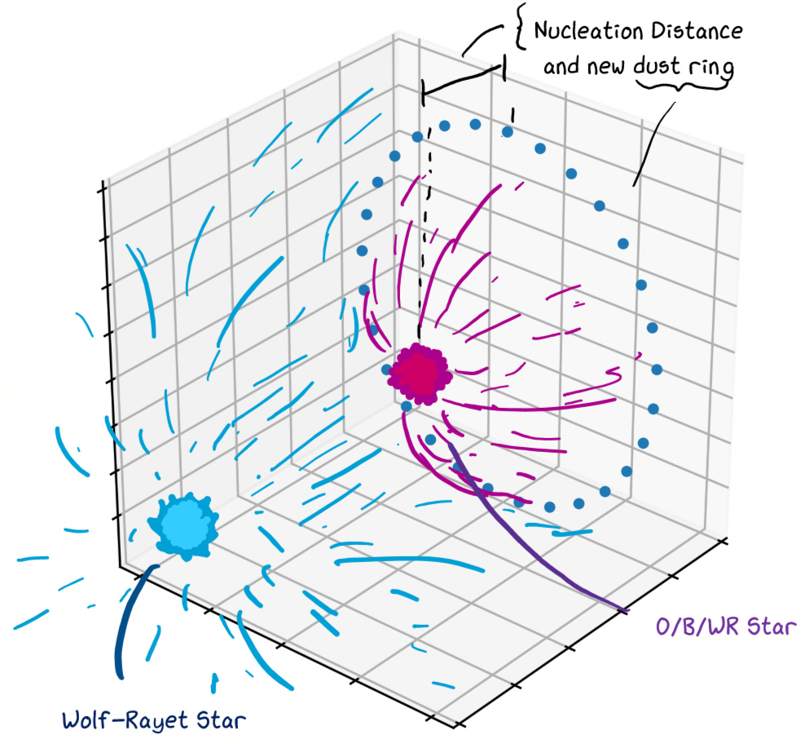
Modelling using geometry
Model the orbits of the two stars
The wind-wind shock enshrouds the star with the weaker wind
Dust nucleation occurs on the surface of the conical shock
At each point in time, we approximate this dust nucleation as a ring of particles on the surface

Slide 25
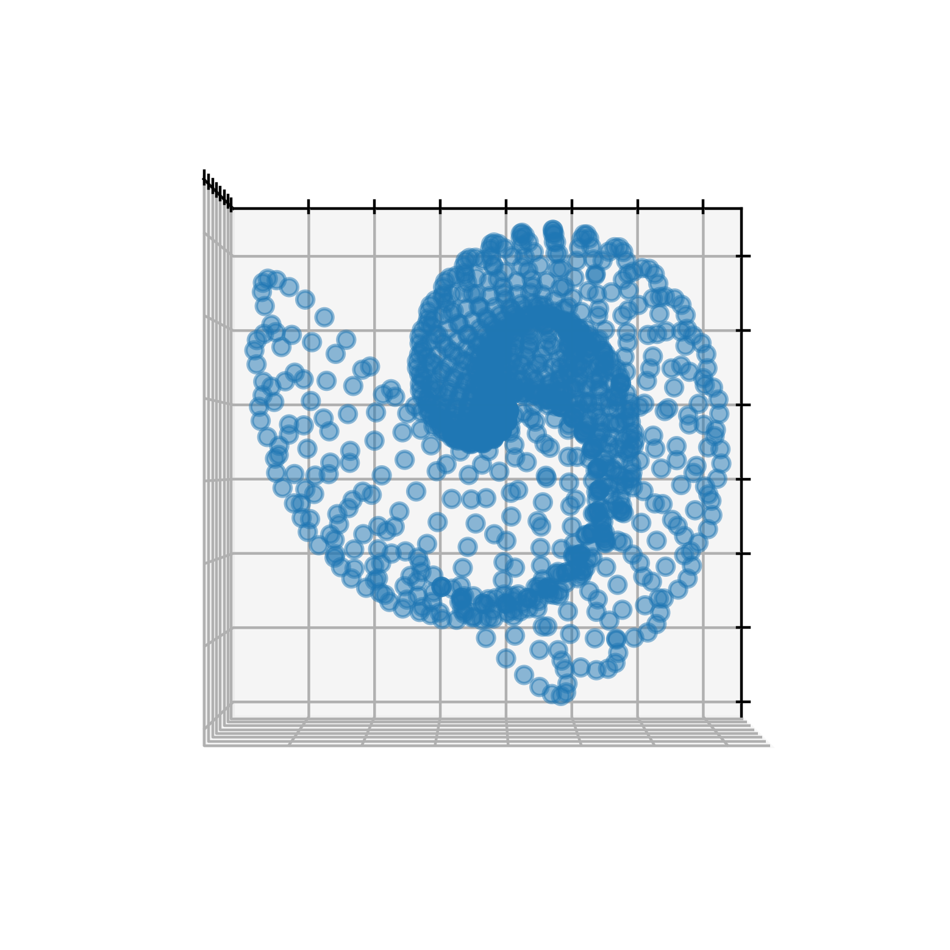
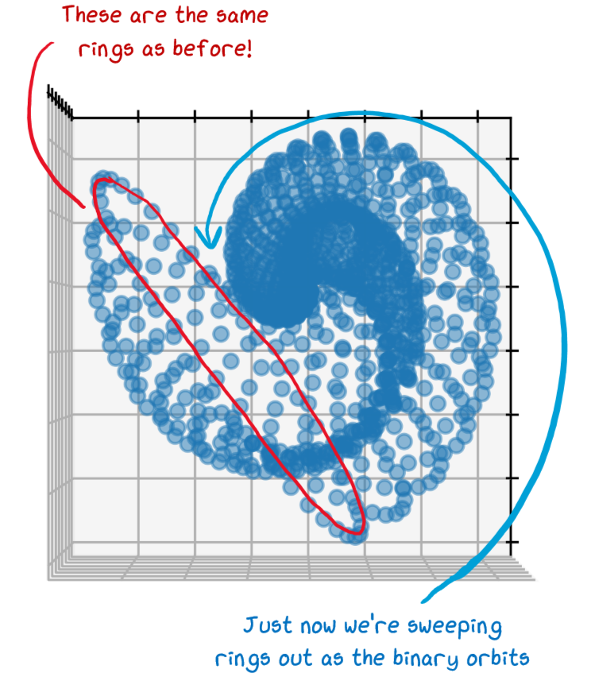
Modelling using geometry

Slide 26
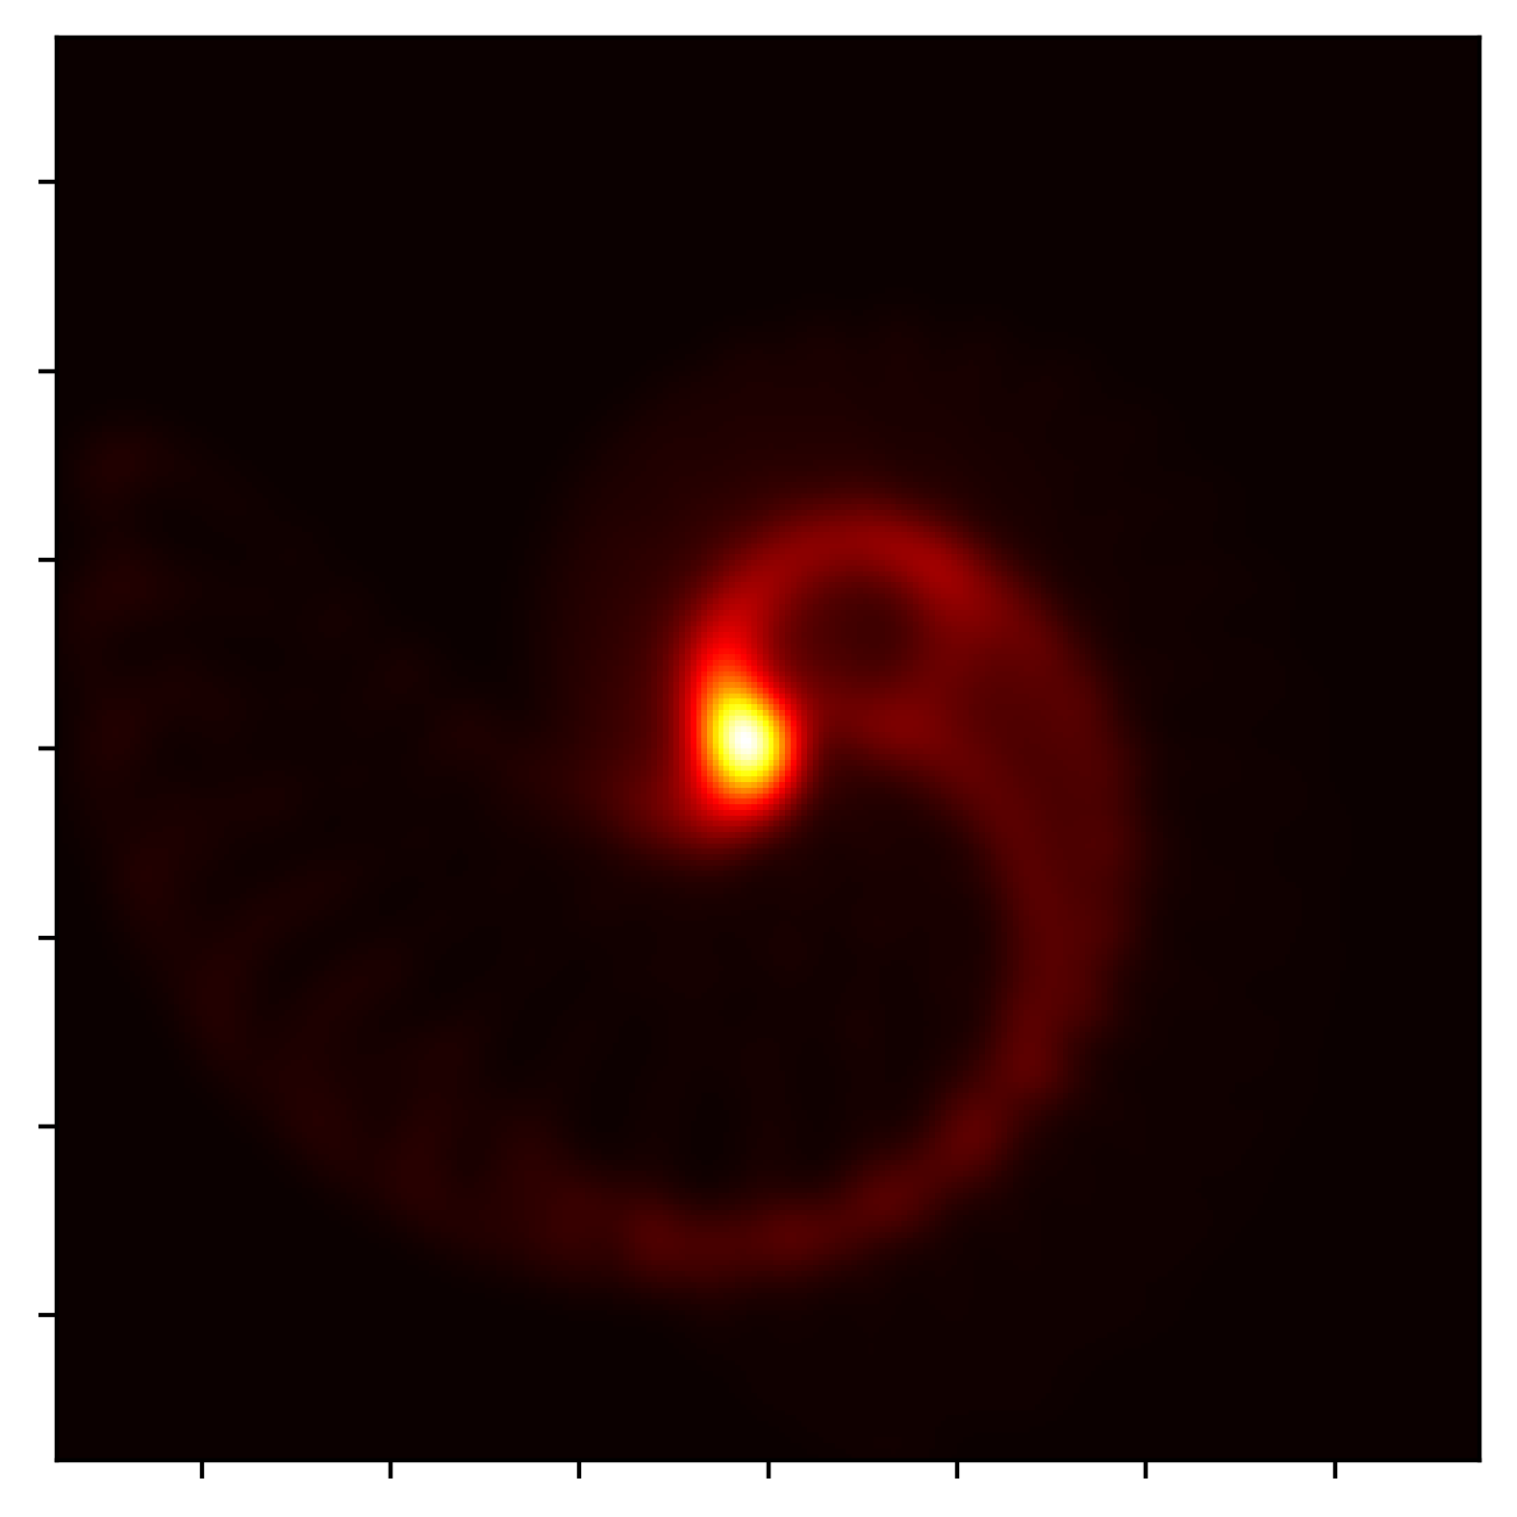

Modelling using geometry

Slide 27
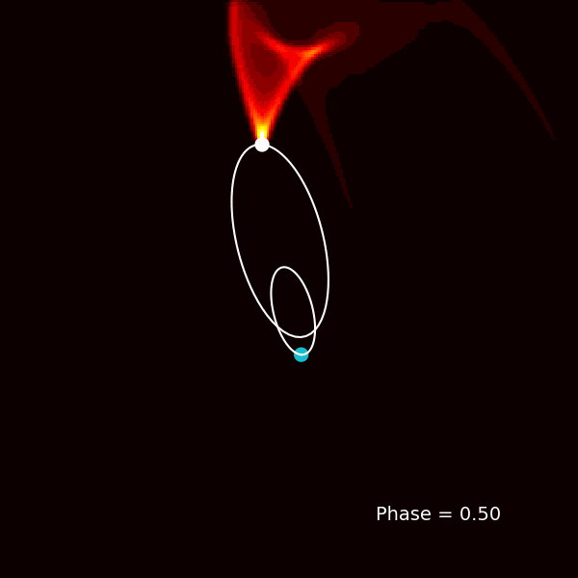
Wolf-Rayet Colliding Wind Binaries

Slide 28
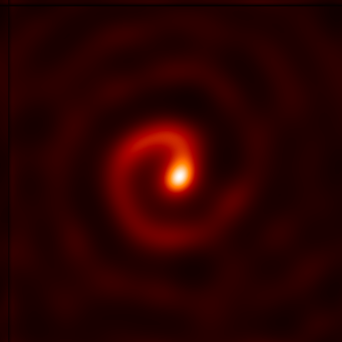
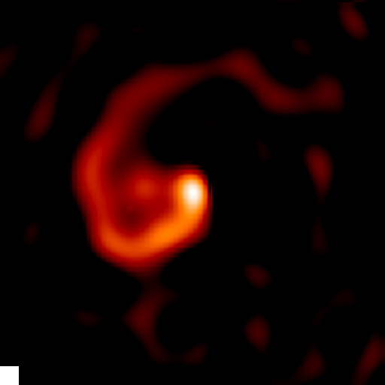
Wolf-Rayet Colliding Wind Binaries
WR 104/Keck
WR 98a/Keck

Slide 29
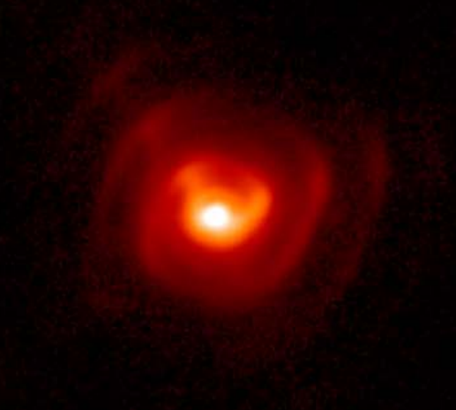
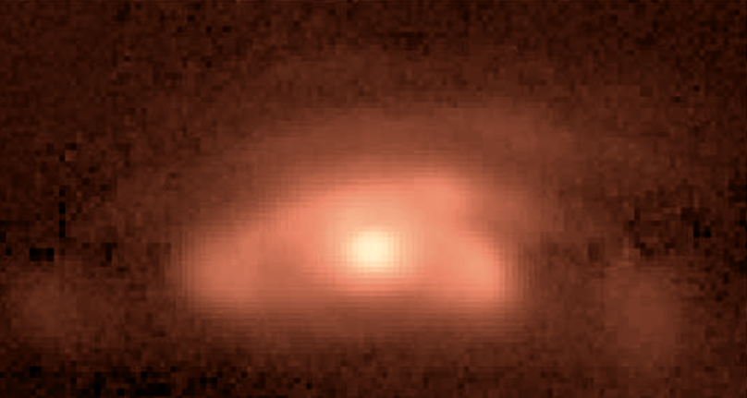
Wolf-Rayet Colliding Wind Binaries
WR 104/Keck
WR 98a/Keck
WR 112/Subaru
WR 48a/Gemini

Slide 30
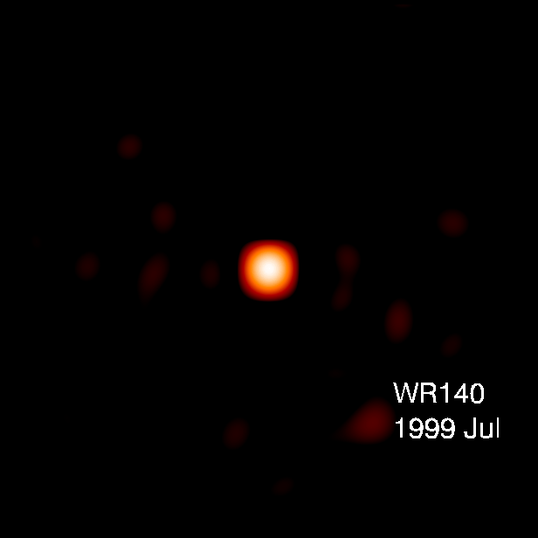
WR 140
WR 140/Keck

Slide 31
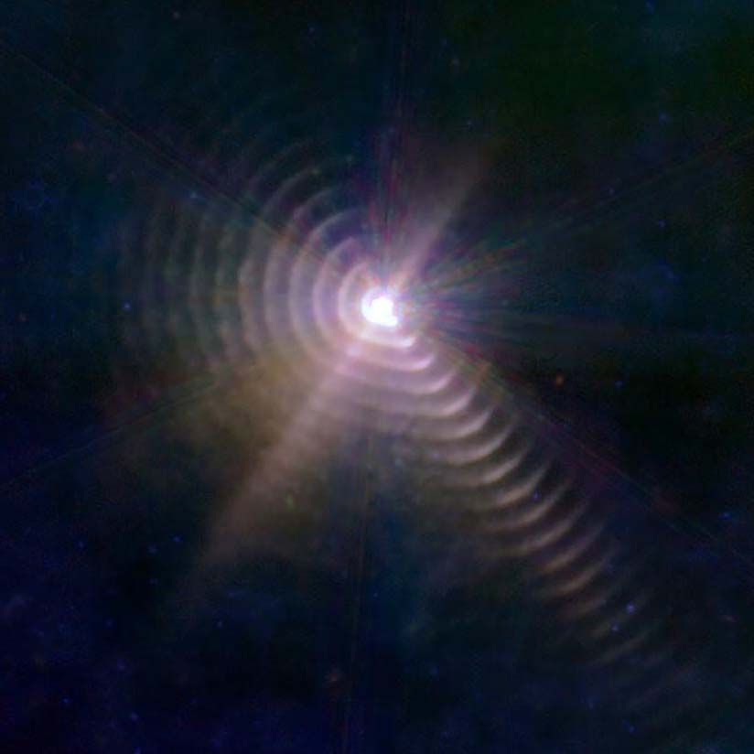
WR 140
WR 140/Keck
WR 140/JWST

Slide 32
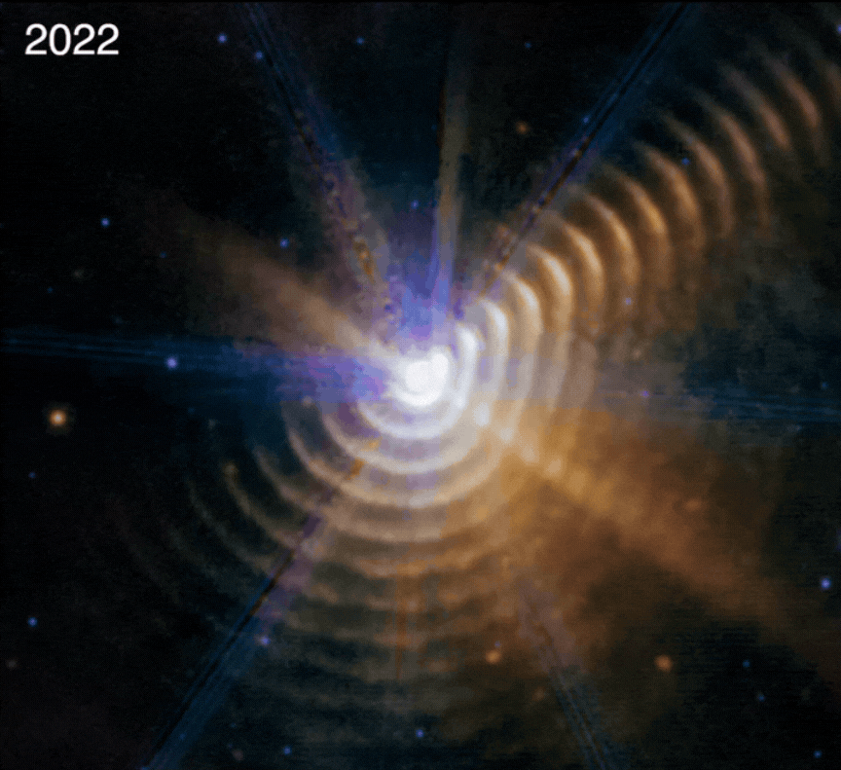
WR 140
WR 140/JWST, Lieb et al 2025

Slide 33
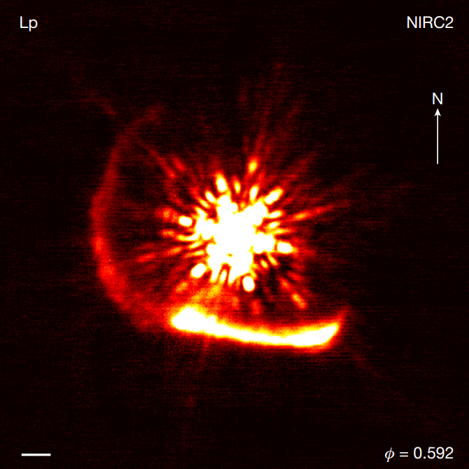
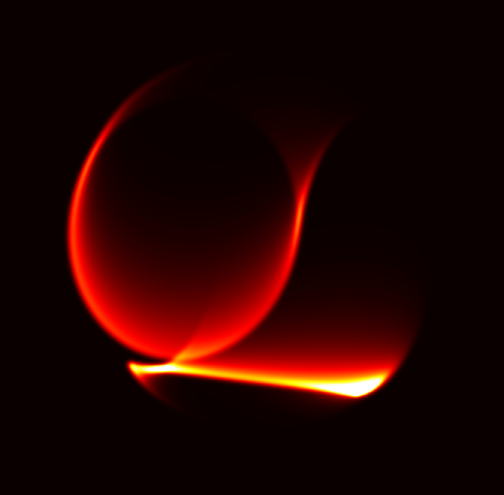
WR 140
WR 140/Keck, Han et al 2022

Slide 34
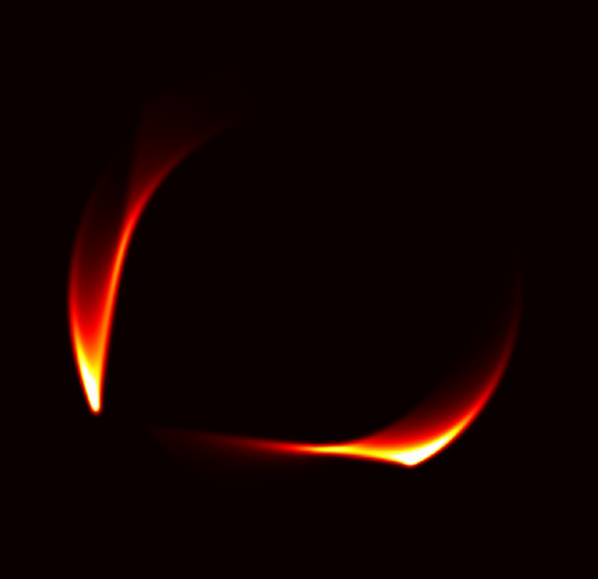
WR 140
WR Orbit
O Star Orbit
Observer view
Top-down view
Han et al 2022

Slide 35

WR 140
WR Orbit
O Star Orbit
Dust Production
Top-down view
Han et al 2022

Slide 36
Apep
The only dusty WR+WR CWB
The longest period dusty CWB
Could harbour a LGRB progenitor
Potentially a tertiary O supergiant, making the system a hierarchical triple
Apep with ESO’s VLT

Slide 37





Apep
O Star
WC Star
WN Star
Apep with ESO’s VLT

Slide 38
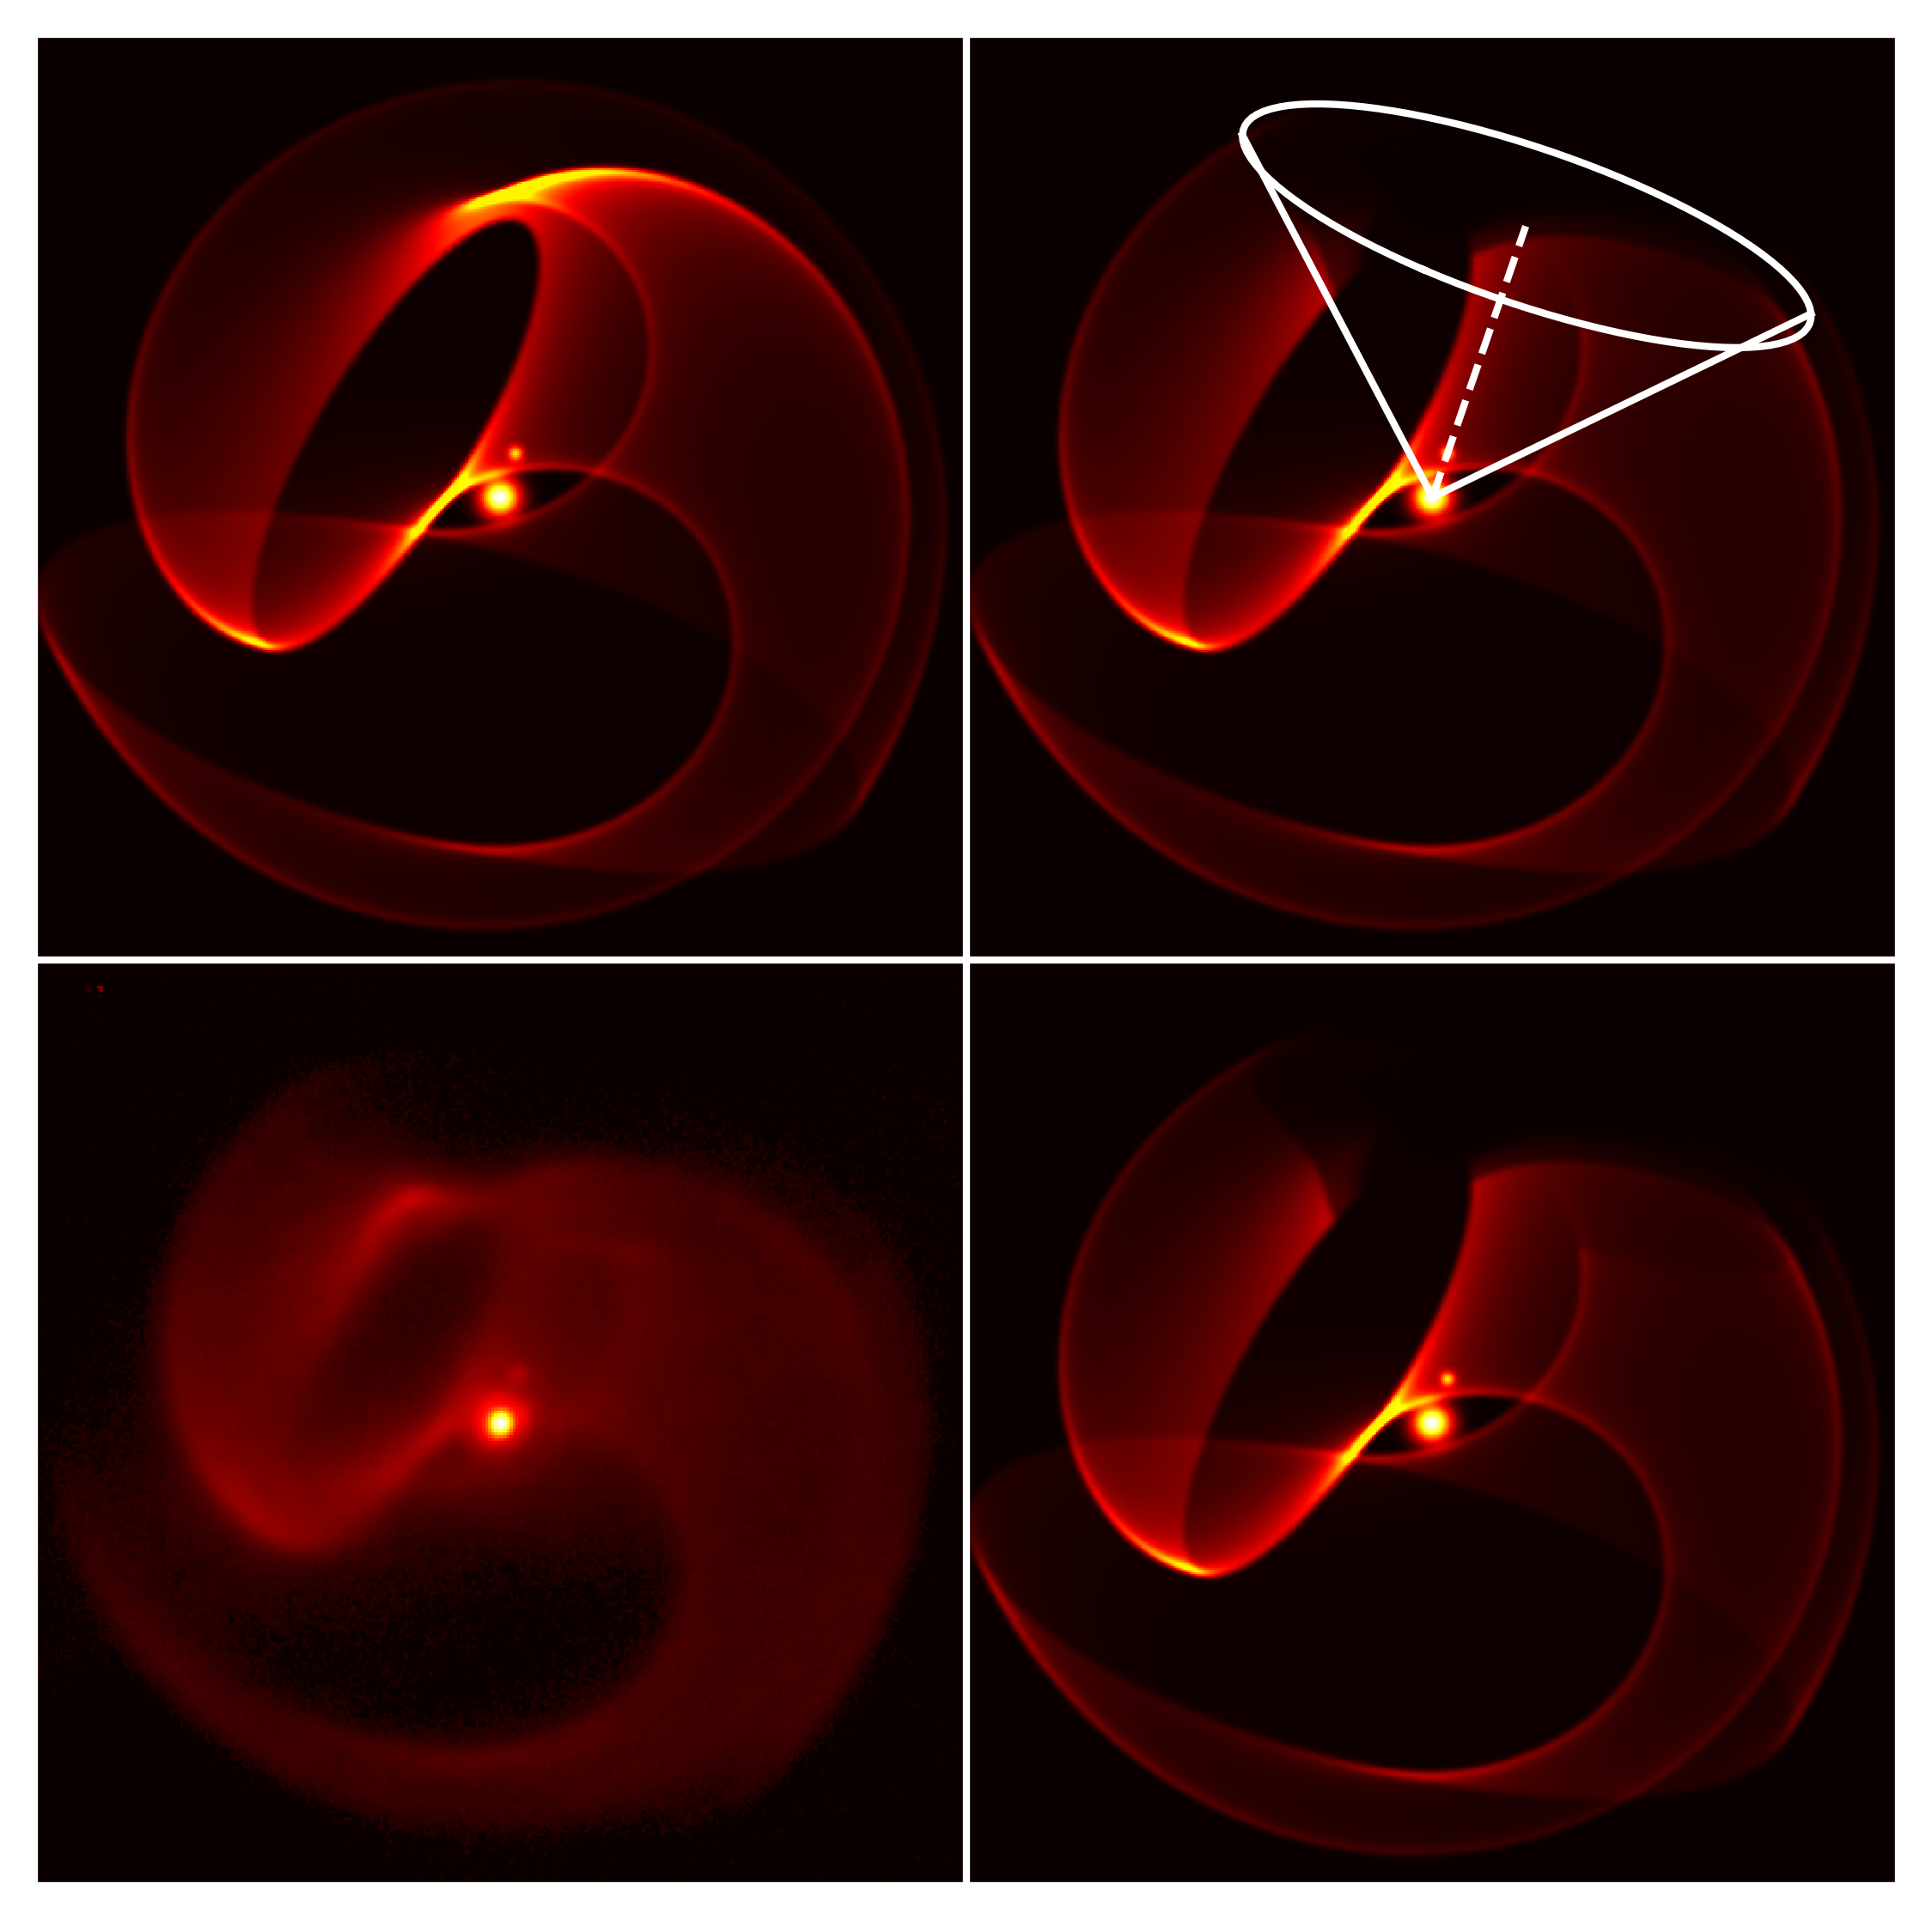
Apep
Standard Apep Model
VLT Image

Slide 39


























































Apep

Slide 40
Apep
Standard Apep Model
Tertiary Shock Geometry
Apep Model incl. Tertiary Shock
VLT Image

Slide 41
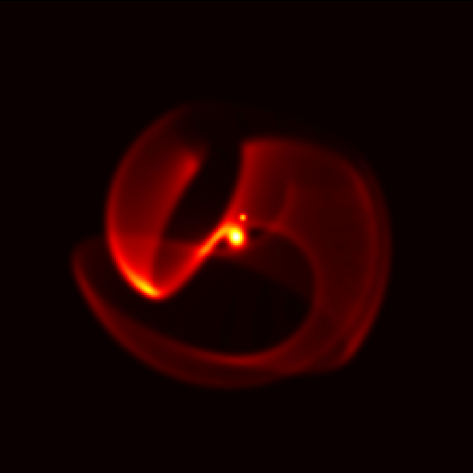
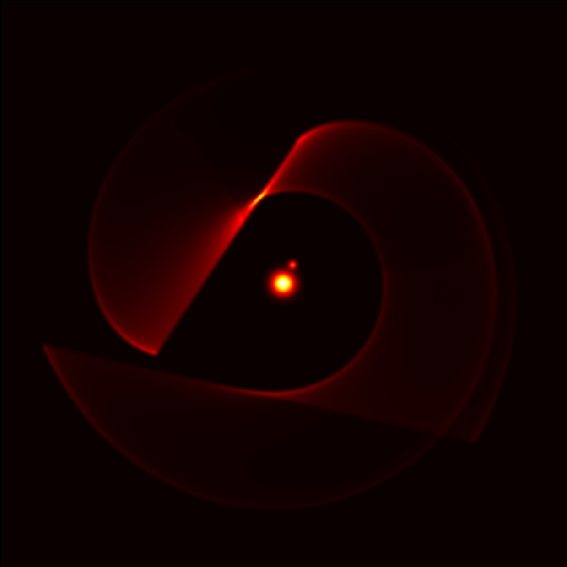
Apep

Slide 42
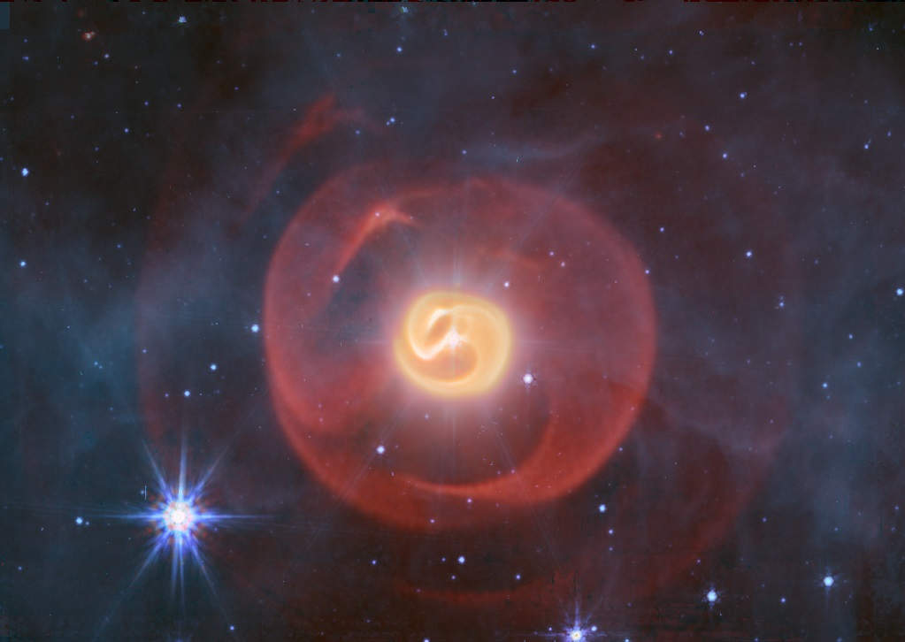

Slide 44
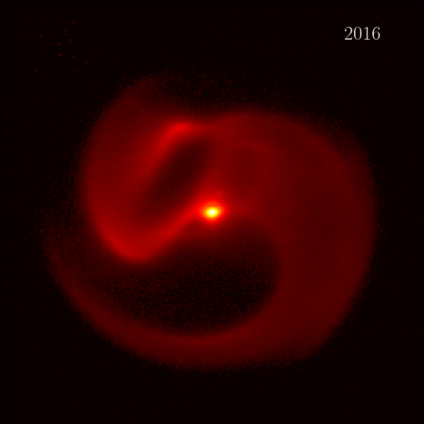
5”

Slide 45
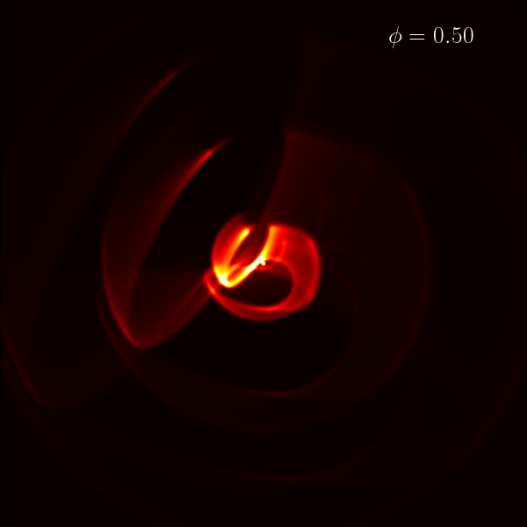
Apep

Slide 46
Apep
WR+WR orbital period is ~235 years
About 8x longer than the next longest period dusty CWB
A confirmed hierarchical triple
The orbit of the inner WR+WR binary has certainly been affected by the O star
No evidence of wind anisotropy in plume geometry
which doesn’t necessarily rule out an anisotropic wind

Slide 47
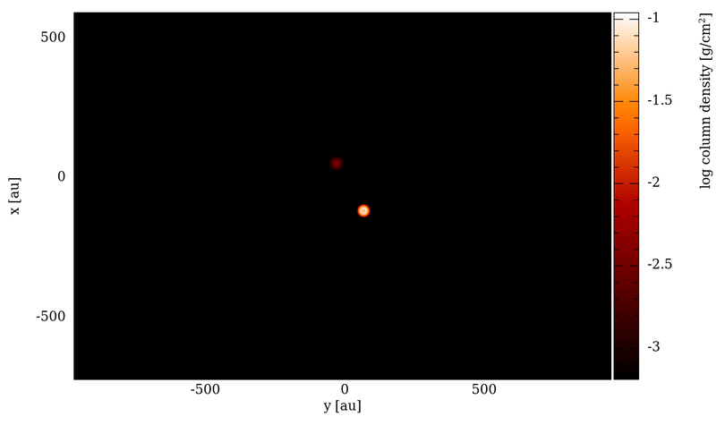
Apep

Slide 48


In summary…
arXiv:2412.12534
I can’t get away from binary interactions
Wolf-Rayet Colliding wind binaries, the rare binary interactions of pre-supernova massive stars, can be simply modelled with geometry
I’ve developed a new and fast code to do this, with handy features like a GUI velocity partitioning, and more physics than ever (ask me about it!)
We have a book chapter on WR-CWBs (QR code) to learn more
The dust cavity in the Apep nebula confirms a hierarchical triple
New JWST+VLT imagery was vital for this and the updated orbit
arXiv:2412.12534

Slide 49
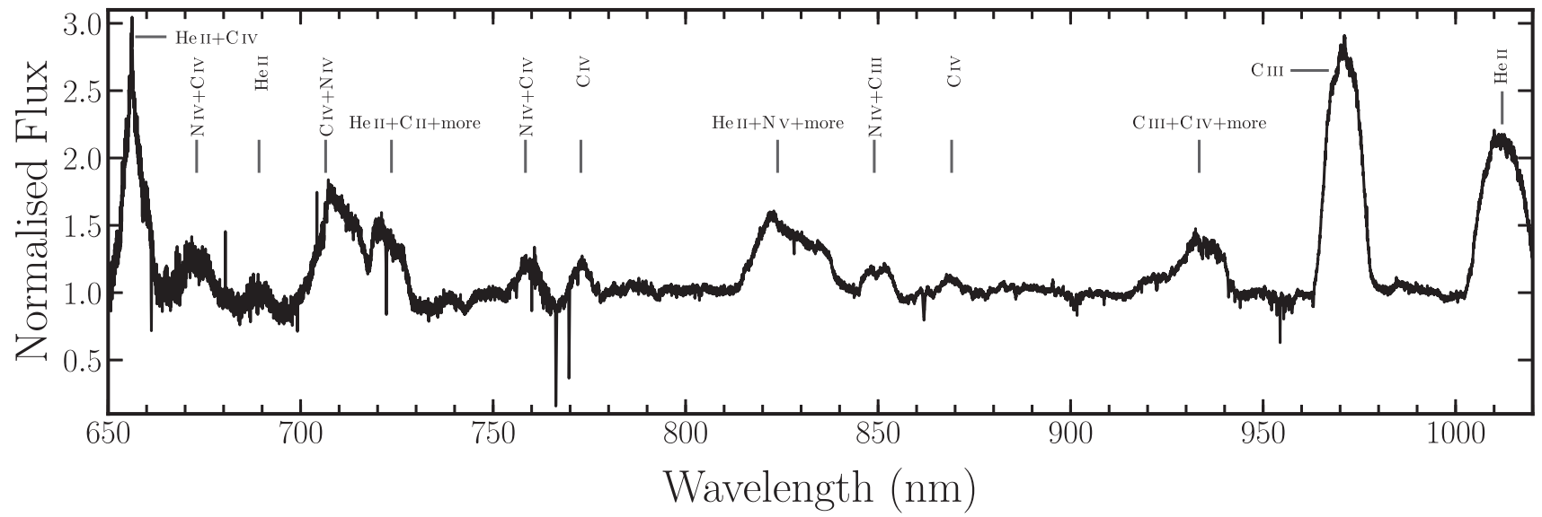
Apep’s wind anisotropy

Slide 50
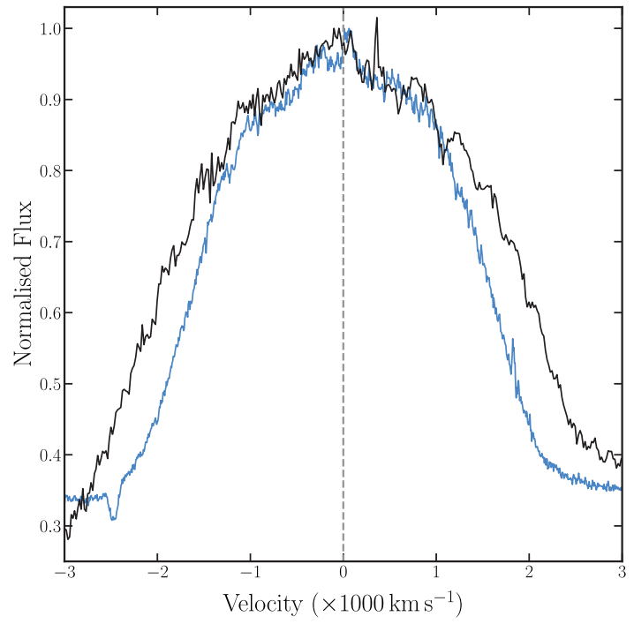
Apep’s wind anisotropy

Slide 51

Apep’s wind anisotropy
2100 + 3500km/s winds
~860km/s nebular expansion

Slide 52






































Apep’s wind anisotropy
Observer
Rapid rotation leads to a fast and sparse wind at the poles, and a slow and dense wind at the equator
We can observe a fast spectroscopic wind simultaneous with a slow nebula expansion
Wind Contributing to Dust Nebula

Slide 53
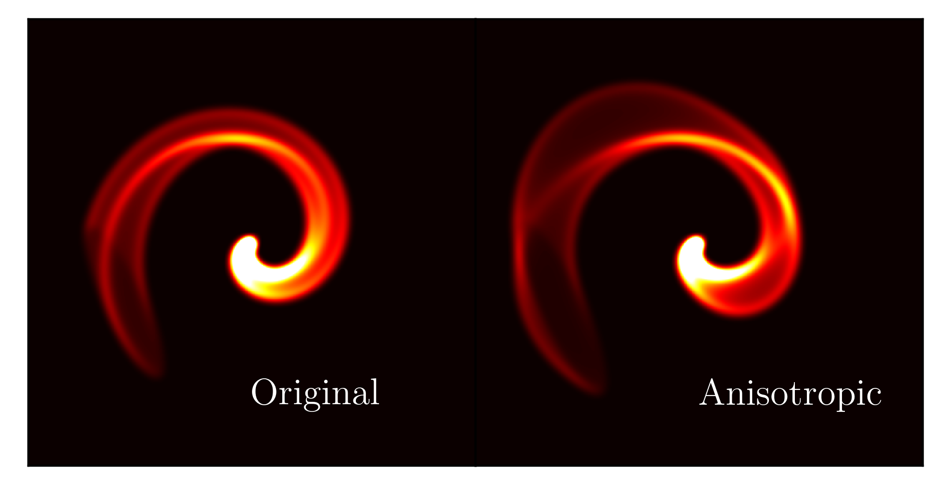
Apep’s wind anisotropy
We emulate anisotropy by changing open angle and expansion speed as a function of true anomaly
This is only relevant when the spin and orbit are misaligned

Slide 54
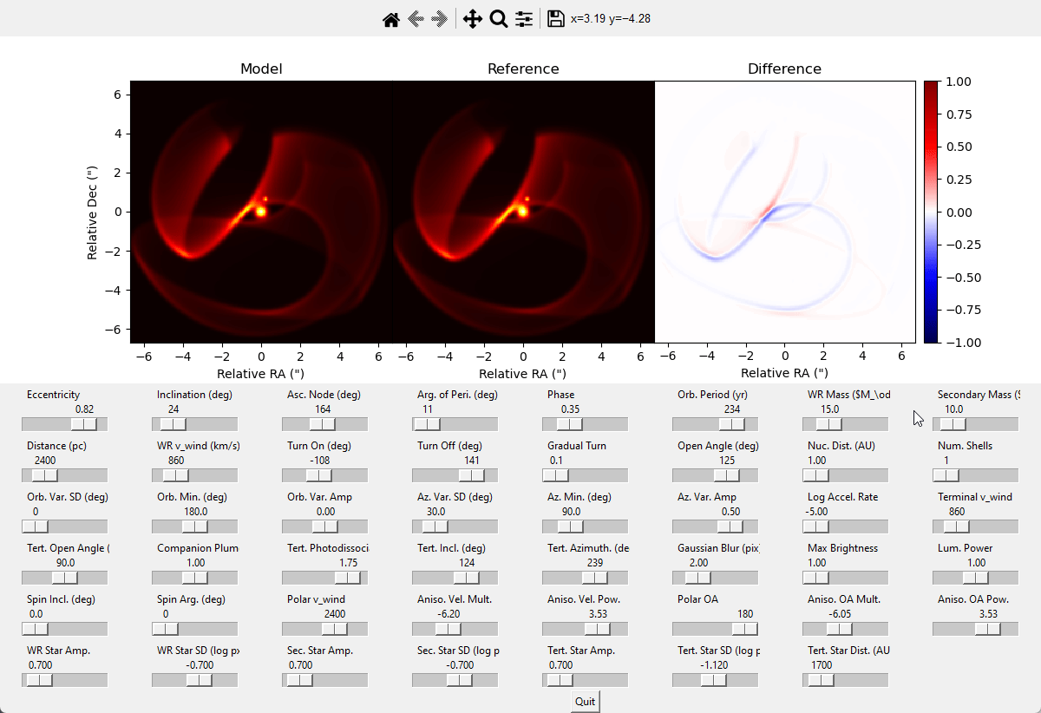
xenomorph – Our new geometric code

Slide 55

xenomorph – Our new geometric code

Slide 56

xenomorph – Our new geometric code
WR 140 from xenomorph
WR 140 from Williams et al (2009)
We can (roughly) model the infrared light curves of CWBs by looking at the brightest pixels over time
More work needed here
E.g. radiative transfer

Slide 57


xenomorph – Our new geometric code
WR 48a with xenomorph
WR 48a from Williams et al (2012)

